Slide 1


Human - Computer
Interaction
Present by Chi Nguyen

Slide 2
CONTENTS OF THIS WORKSHOP
Introduction
  What are the style guide/ the design system ?
  Creating the style guide/ the design system ?
Principles for UI design
Interaction & Animation
Tools & software in UI design
Practises
Question and Answer

Slide 3
WHAT ARE THE STYLE GUIDE
Your style guide, or branding guidelines document, is an instruction manual for how to use your company's branding materials. The point of a style guide is consistency.
The style guide explains the values of your brand and, where relevant, its history and its evolution. It shows the logos of your brand and clearly explains when and how they should be used.
It also tries to anticipate potential misuses.
It shows the colors of your brand with numerical breakdowns of those colors for use in print and on screen.
A style guide explicitly states the appropriate usage of other design elements of your brand, like the type choices and the use of imagery, as well as the appropriate writing tone to be used in all communication.

Slide 4
PURPOSE OF STYLE GUIDE
Ensures consistent implementation of brand
Expands design thinking
Removes areas of ambiguity
Provides future design direction
Explains rather than patronizes

Slide 5
WHAT TO INCLUDE IN THE STYLE GUIDE
Position statement
Voice
Social Media
Document templates
Collateral
Forms
Gift items
Signage
Uniforms

Slide 6
CREATING THE STYLE GUIDE?
STYLE
GUIDE

Slide 7
ELEMENTS OF A STYLE GUIDE
Position Stament
and Voice
Logos
Typography
Brand colors
Imagery

Slide 8
ELEMENTS OF A STYLE GUIDE
What’s the company about?
Tone
Position Stament
and Voice
Funny
Formal
Respectful
Enthusiastic
Serious
Casual
Irreverent
Matter-of-fact

Slide 9
ELEMENTS OF A STYLE GUIDE
What’s the company about?
Tone
Style manual
Position Stament
and Voice

Slide 10
ELEMENTS OF A STYLE GUIDE
Logos
History, meaning, and components
Tagline usage
Alternate versions
Sizing, positioning and clear space
Sub-brands
File formats

Slide 11
ELEMENTS OF A STYLE GUIDE
Readability and accessibility
Style and pedigree
Availability
Typography

Slide 12
ELEMENTS OF A STYLE GUIDE
Primary and secondary color
Color by names and numbers
Making the color palettes available
Brand colors

Slide 13
ELEMENTS OF A STYLE GUIDE
Use of imagery
Illustration & photography
Types of images
Image treatments
Technical specs
Imagery

Slide 14
PRINCIPLES FOR UI DESIGN
Shape
Colour
Layout / guide/ margins
Hierarchie
Typography/ Fonts
Image / Illustration
Eye flow/ Eye trick
Communicate/ convey the message

Slide 15
PRINCIPLES FOR
UI DESIGN
Place users in control of the interface
Make it comfortable to interact with a product
Reduce cognitive load
Make user interfaces consistent

Slide 16
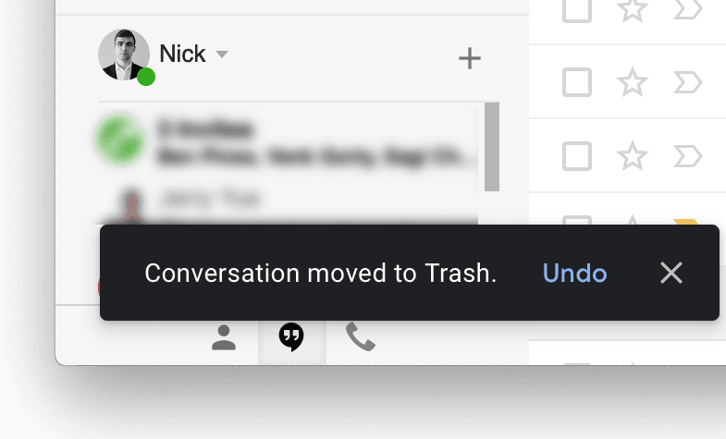
PRINCIPLES FOR
UI DESIGN
Make actions reversible – be forgiving
Place users in control of the interface

Slide 17
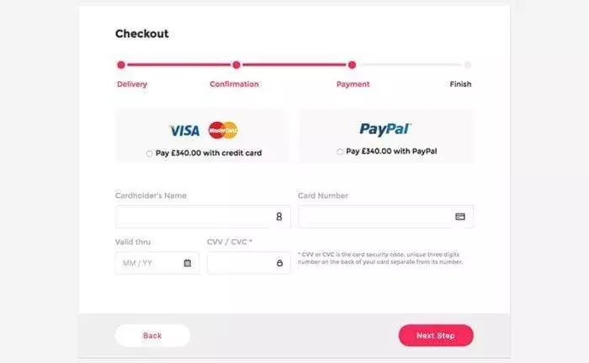
PRINCIPLES FOR
UI DESIGN
Make actions reversible – be forgiving
Create an easy-to-navigate interface
  Provide visual cues
  Predictability
Place users in control of the interface

Slide 18
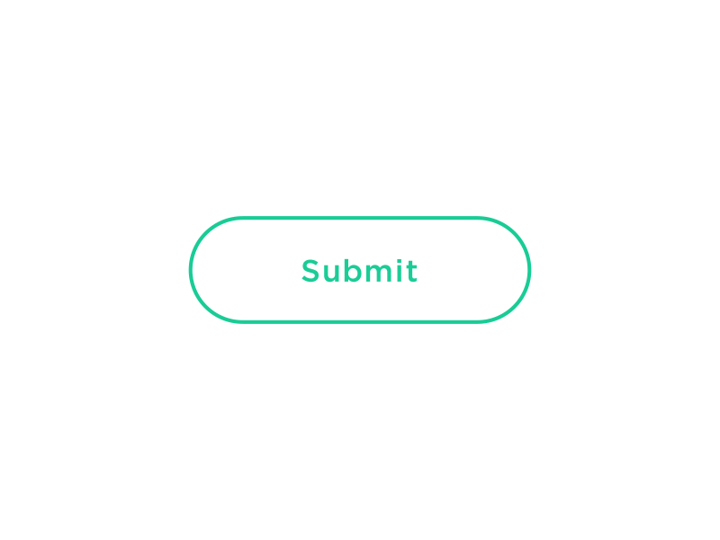
PRINCIPLES FOR
UI DESIGN
Make actions reversible – be forgiving
Create an easy-to-navigate interface
Provide informative feedback
– be acknowledging
Place users in control of the interface

Slide 19
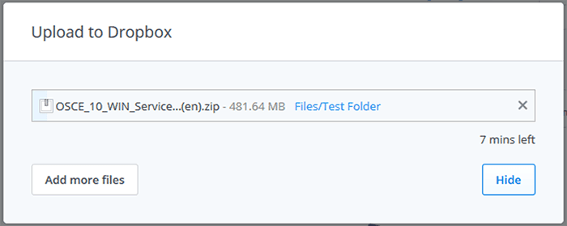
PRINCIPLES FOR
UI DESIGN
Make actions reversible – be forgiving
Create an easy-to-navigate interface
Provide informative feedback
– be acknowledging
Show the visibility of system status
Place users in control of the interface

Slide 20
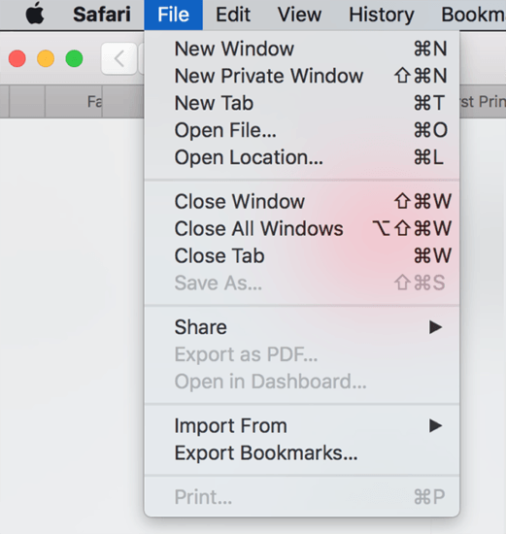
PRINCIPLES FOR
UI DESIGN
Make actions reversible – be forgiving
Create an easy-to-navigate interface
Provide informative feedback
– be acknowledging
Show the visibility of system status
Accommodate users with different skill levels
Place users in control of the interface

Slide 21
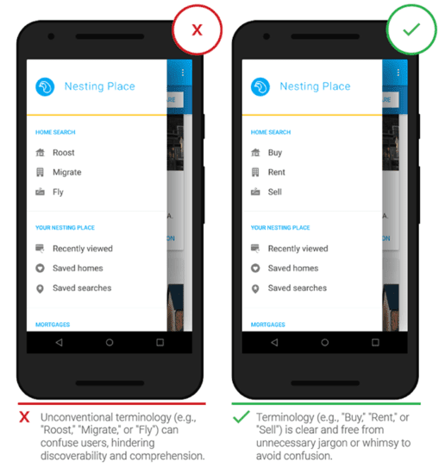
PRINCIPLES FOR
UI DESIGN
Make it comfortable to interact with a product
Eliminate all elements that are not helping your users
Don’t ask users for data they’ve already entered
Avoid jargon and system-oriented terms

Slide 22
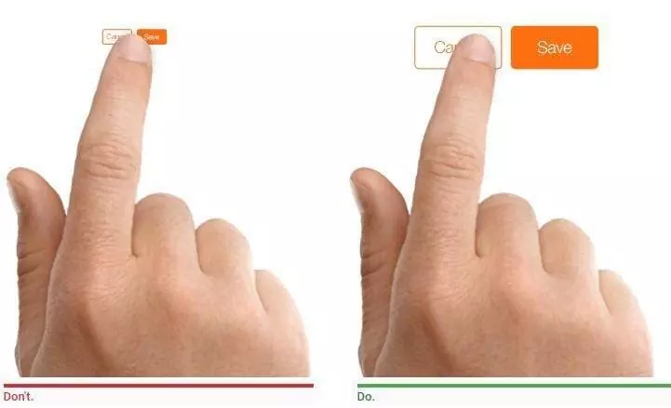
Make it comfortable to interact with a product
Eliminate all elements that are not helping your users
Don’t ask users for data they’ve already entered
Avoid jargon and system-oriented terms
Apply Fitts’s Law to interactive elements
Design accessible interfaces

Slide 23
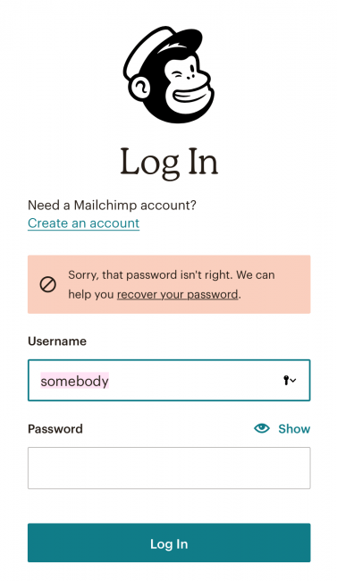
Make it comfortable to interact with a product
Eliminate all elements that are not helping your users
Don’t ask users for data they’ve already entered
Avoid jargon and system-oriented terms
Apply Fitts’s Law to interactive elements
Design accessible interfaces
Use real-world metaphors
Engineer for errors

Slide 24
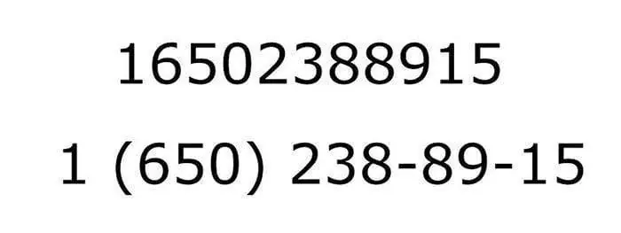
PRINCIPLES FOR
UI DESIGN
Chunking for sequences of information or actions
Reduce cognitive load

Slide 25

PRINCIPLES FOR
UI DESIGN
Chunking for sequences of information or actions
Reduce the number of actions required to complete a task
Recognition over recall
Reduce cognitive load

Slide 26
PRINCIPLES FOR
UI DESIGN
Chunking for sequences of information or actions
Reduce the number of actions required to complete a task
Recognition over recall
Promote visual clarity
When designing layouts:
  Avoid presenting too much information at one time on the screen. This results in visual clutter.
  Apply the general principles of content organization such as grouping similar items together, numbering items, and using headings and prompt text.
Reduce cognitive load

Slide 27
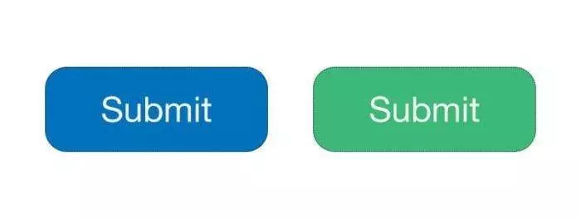
Visual consistency (style)
Make user interfaces consistent

Slide 28

Visual consistency (style)
Functional consistency (behavior)
Make user interfaces consistent

Slide 29

PRINCIPLES FOR
UI DESIGN
Visual consistency (style)
Functional consistency (behavior)
Consistent with user expectations
  Follow platform conventions.
  Don’t reinvent patterns.
  Don’t try to reinvent terminology.
Make user interfaces consistent

Slide 30

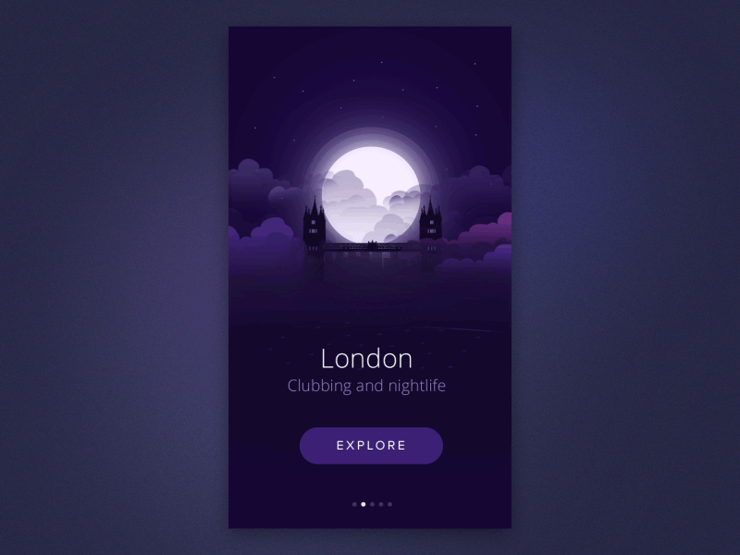
03
INTERACTION & ANIMATION

Slide 31
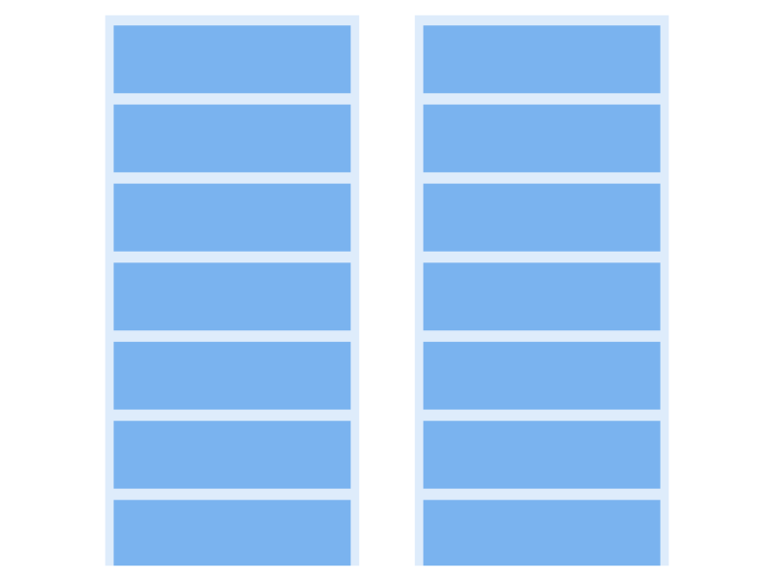

Slide 32
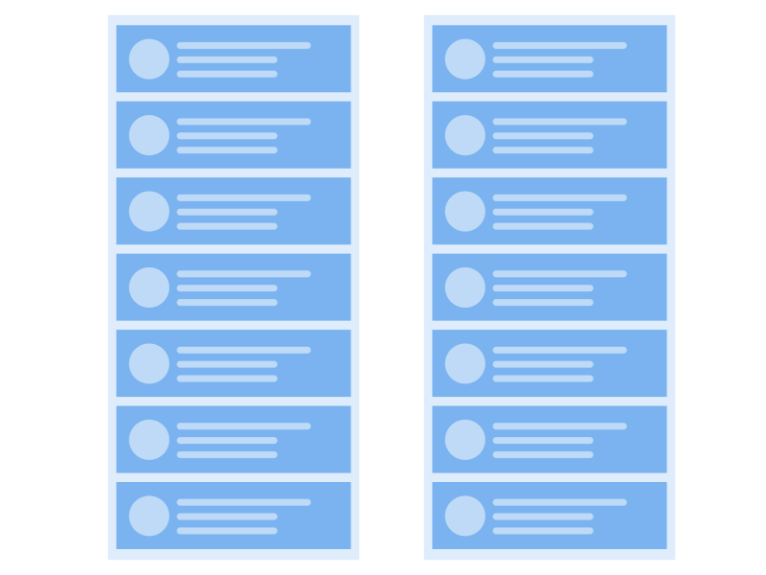

Slide 33
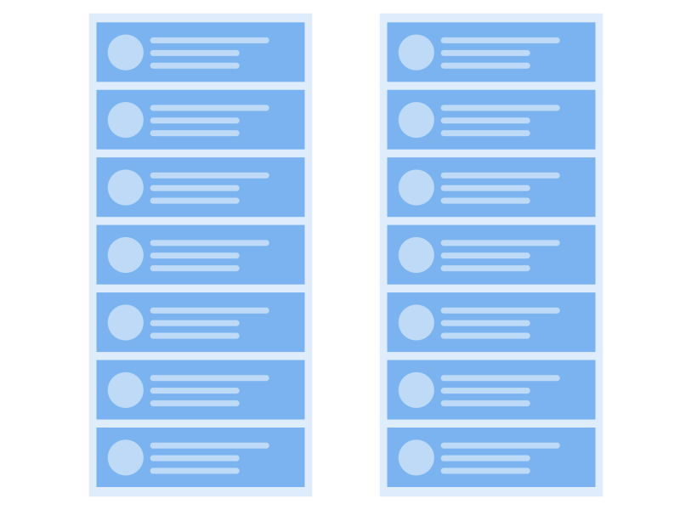

Slide 34

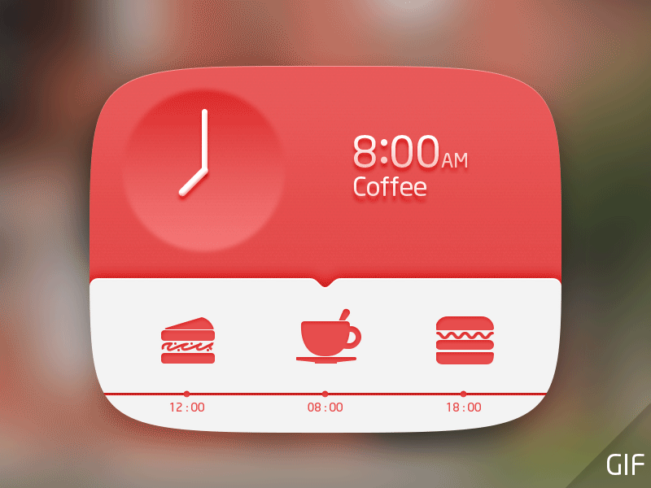
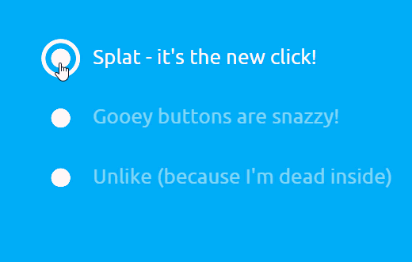

Slide 35
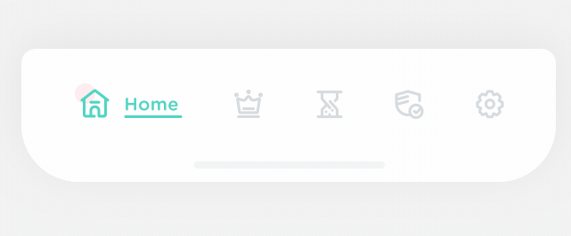
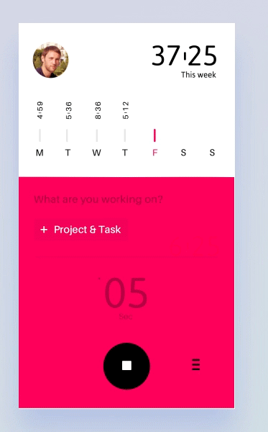
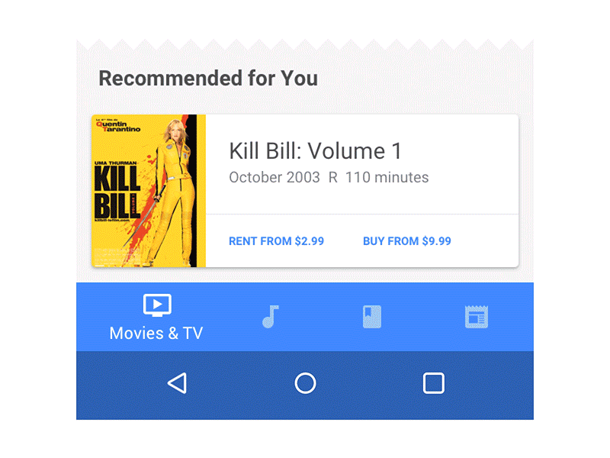

Slide 36

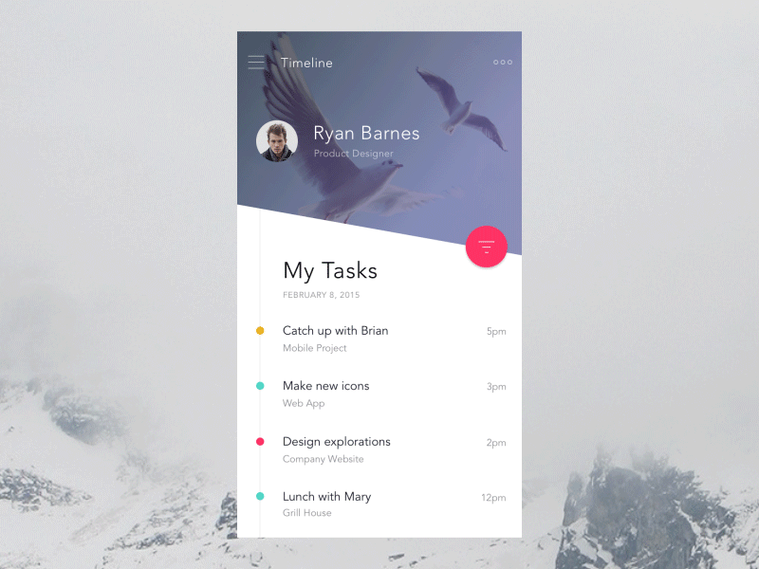

Slide 37
SOFTWARE
04

Slide 38


Thanks!
Do you have any questions?
chrizmonkey@gmail.com
+84 0937 566 561

